Slide 1

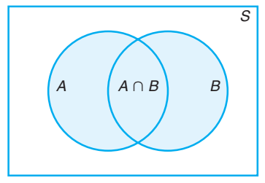
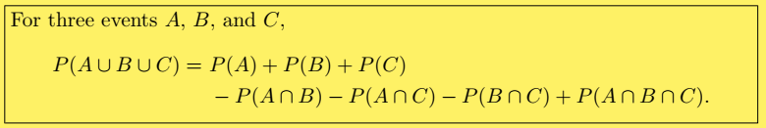
Additive Rule: Not - Mutually Exclusive Events

Slide 2

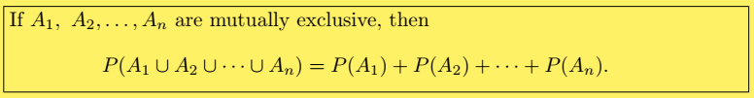
Additive Rule: Mutually Exclusive Events

Slide 3
Example # 08 – 10
8. John is going to graduate from an industrial engineering department in a university by the end of the semester. After being interviewed at two companies he likes, he assesses that his probability of getting an offer from company A is 0.8, and his probability of getting an offer from company B is 0.6. If he believes that the probability that he will get offers from both companies is 0.5, what is the probability that he will get at least one offer from these two companies?
What is the probability of getting a total of 7 or 11 when a pair of fair dice is tossed?
If the probabilities are, respectively, 0.09, 0.15, 0.21, and 0.23 that a person purchasing a new automobile will choose the color green, white, red, or blue, what is the probability that a given buyer will purchase a new automobile that comes in one of those colors?
Notes:
(8) 0.9 (not-Mutually) (9) (6 + 2)/36 (mutually)= 8/36 = 2/9 (10) Mutually = 0.68

Slide 4
Examples (11 – 12)
If the probabilities that an automobile mechanic will service 3, 4, 5, 6, 7, or 8 or more cars on any given workday are, respectively, 0.12, 0.19, 0.28, 0.24, 0.10, and 0.07, what is the probability that he will service at least 5 cars on his next day at work?
Suppose the manufacturer’s specifications for the length of a certain type of computer cable are 2000 ± 10 millimeters. In this industry, it is known that small cable is just as likely to be defective (not meeting specifications) as large cable. That is, the probability of randomly producing a cable with length exceeding 2010 millimeters is equal to the probability of producing a cable with length smaller than 1990 millimeters. The probability that the production procedure meets specifications is known to be 0.99.
(a) What is the probability that a cable selected randomly is too large? (b) What is the probability that a randomly selected cable is larger than 1990 millimeters?
Notes:
P(E’) = 0.31 P(E) 0.69 (12) P(S) = P(L) = (1-0.99)/2 = 0.005 & P (X>1990) = 1 – P(S) = 1 – 0.005 = 0.995

Slide 5
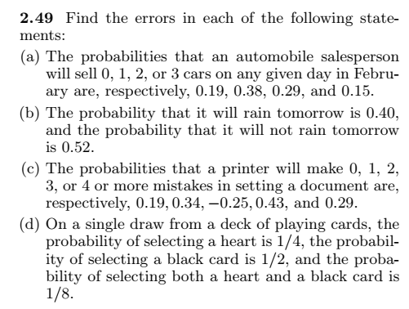
Exercises

Slide 6
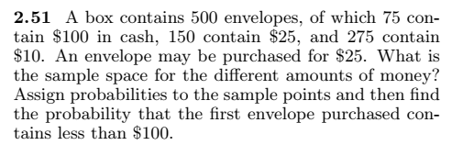

Slide 7

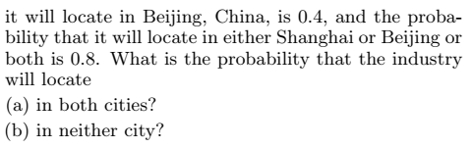
Notes:
(a) P(S&B) = (non-mutually) (b) P(S’&B’) = 0.2

Slide 8
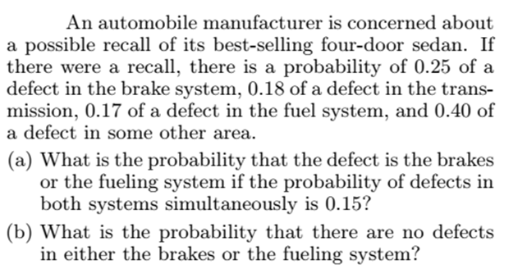
Notes:
A = Defect in brake, B = Defect in fuel, (a) P (A U B) = 0.27 (b) P (No defect ) = 0.73

Slide 9
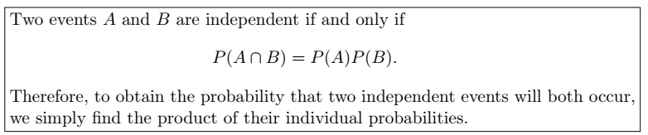
The Product Rule: Independent Events

Slide 10
Some important results for Independent events
(i) A’ and B are independent = P (A’∩ B ) = P(A’).P(B)
(ii) A and B’ are independent = P (A ∩ B’) = P(A).P(B’)
(iii) A’ and B’ are independent = P(A’ ∩ B’) = P(A’).P(B’)
If A and B are independent then they are not mutually exclusive.
If A, B, and C are independent, then P(A ∩B ∩ C)’ = 1 - P(A).P(B).P(C)
If A, B, and C are independent, then P (A U B U C) = 1 – P(A’ ∩ B’ ∩ C’)

Slide 11

Relationship among events

Slide 12
Examples # 13 – 14
A small town has one fire engine and one ambulance available for emergencies. The probability that the fire engine is available when needed is 0.98, and the probability that the ambulance is available when called is 0.92. In the event of an injury resulting from a burning building, find the probability that both the ambulance and the fire engine will be available, assuming they operate independently.
A bag contains 5 red and 7 black balls. A ball is drawn at random from the bag, the color is noted and the ball is replaced. A second balls is then drawn. Find the probability that the first balls is red and the second is black.
Notes:
P(A&B) = 0.9016 (14) P(A&B) = 35/144

Slide 13
Examples 15 – 17
(15). A die is rolled two times. Find the probability of obtaining a 5 on the first thrown and an even number on the second thrown.
(16). The probability that Ahsan will be alive in 30 years is 0.4 and the probability that Bilawal will be alive in 30 years is 0.8. What is the probability that: (a) both will be alive in 30 years
(b) both of them die (c) Ahsan will be alive and B dead.
(17). A town has two fire engines operating independently. The probability that a specific engine is available when needed is
0.96.
(a) What is the probability that neither is available when needed? (b) What is the probability that a fire engine is available when needed?
Notes:
(15) ½ (16) (a) 0.32, (b) =0.12, (c) = 0.08
(17) P(neither available = A’&B”) = 0.0016 (b)P(available when needed)=0.9984.

Slide 14
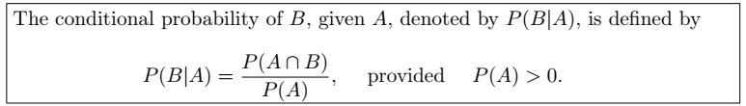
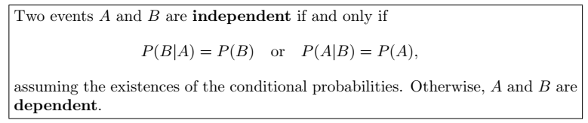
The Product Rule: Dependent Events

Slide 15
Example # 18
(18). Suppose that we have a fuse box containing 20 fuses, of which 5 are defective. If 2 fuses are selected at random and removed from the box in succession without replacing the first, what is the probability that both fuses are defective?
(19). Two cards are drawn in succession from a deck of 52 playing cards without replacement. What is the probability that both cards a are spades.
(20). A box contains 8 tickets bearing the numbers 1, 2, 3, 4, 5, 6, 8, 10. One ticket is drawn and kept aside. Then a second ticket is drawn. What is the probability that both the tickets show even numbers.
Notes:
(18) P(A&B) = 1/19. (19).1/17 (20). 5/14

Slide 16
Example # 21
(21). In a certain college 25% of the students passed Mathematics, 15% of the students passed statistics and 10% of the students passed both mathematics and Statistics. A students is selected at random.
(a) if he passed statistics, what is the probability that he passed mathematics.
(b) if he passed mathematics, what is the probability that he passed statistics.
(22). Suppose a pair of dice is tossed once. If it is known that one die shows a 3. what is the probability that other die shows a 6.
Notes:
(21) a. 0.10/0.15 = 2/3 (b) 2/5 (22) P(B\A) = [2/36]/11/36 = 2/11

Slide 17
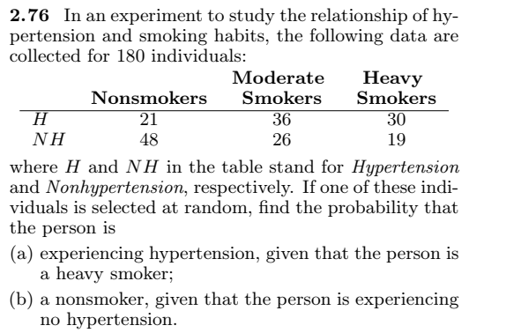
Example # 22
Notes:
P(A\B) = 30/49. P(c\A’)=48/93 total = 180

Slide 18
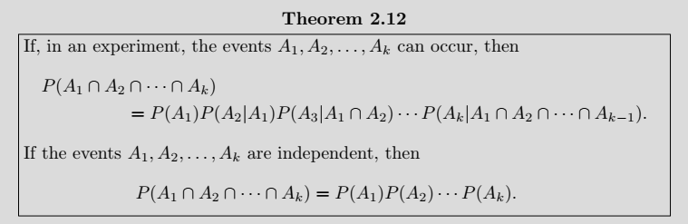
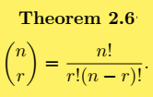

Example # 23
(2.91) Find the probability of randomly selecting 4 good quarts of milk in succession from a cooler containing 20 quarts of which 5 have spoiled, by using
(a) the first formula of Theorem 2.12 on page 68.
(b) the formulas of Theorem 2.6 and Rule 2.3 on pages 50 and 54, respectively.
Notes:
(a) = (b) = (c) = 91/323

Slide 19
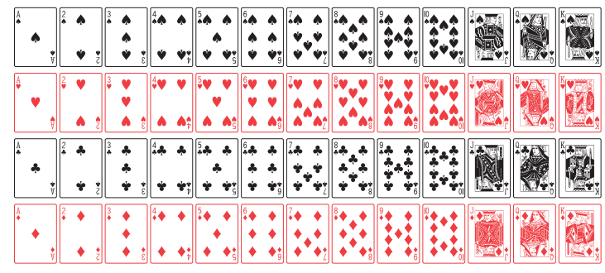

Slide 20
Example # 23
A card is drawn is random from a deck of ordinary playing cards. What is the probability that it is a diamond, a face card or a king?
Solution:
Let A = the card drawn is diamond
B = the card drawn is face card, &
C = the card drawn is a king
P (A U B U C) =
Notes:
P (A U B U C ) = 22/52 = 0.423

Slide 21
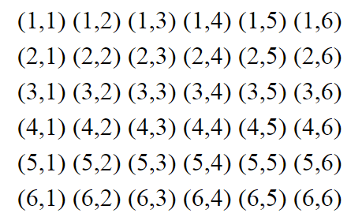
Example # 24
A man tosses two fair dice. What is the conditional probability that the sum of two dice will be 7, given that
(i) the sum is odd. (B)
(ii) the sum is greater than 6. (C)
(iii) the two dice had the same outcome. (D)
Solution:
Notes:
P(A) = 6/36
P(A|B) = (6/36)*(36/18) = 1/3 P(A|C) = (6/36)*(36/21) P(A|D) = 0 * (36/6) = 0

Slide 22
Example # 25
Two coins are tossed. What is the conditional probability that two heads results, given that there is at least one head?
Notes:
P(A|B) = 1/3

Slide 23
Example # 25
Two events A & B are such that P(A) = 1/4, P(A|B)=1/2, P(B|A) = 2/3
Are A and B independent events?
Are A and B mutually exclusive events?
Find P(A∩B)
Solution:
Notes:
(i) Not independent, P(A) not equal to P(A|B) (ii) if mutually exclusive then it should be P(A|B) = 0 but here P(A|B) = 1/2 (iii) P(A∩B)=P(A).P(B|A) = (1/4)*((2/3) = 1/6

Slide 24
Example # 26
In a certain assembly plant, three machines, B1, B2, and B3, make 30%, 45%, and 25%, respectively, of the products. It is known from past experience that 2%, 3%, and 2% of the products made by each machine, respectively, are defective. Now, suppose that a finished product is randomly selected. What is the probability that it is defective?
Solution:
A: the product is defective, B1: the product is made by machine B1, B2: the product is made by machine B2, B3: the product is made by machine B3,
Notes:
0.0245.

Slide 25
Tree Diagram for Example # 26
P(A|B1) = 0.02
P(B1) = 0.3
P(A|B2) = 0.03
P(B2) = 0.45
P(B3) = 0.25
P(A|B3) = 0.02

Slide 26
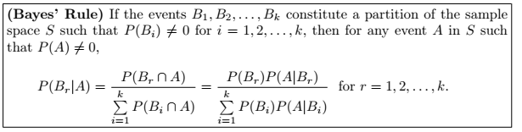
Baye’s Rule

Slide 27

Example # 27
In a certain assembly plant, three machines, B1, B2, and B3, make 30%, 45%, and 25%, respectively, of the products. It is known from past experience that 2%, 3%, and 2% of the products made by each machine, respectively, are defective. Now, suppose that a finished product is randomly selected. What is the probability that it is defective? if a product was chosen randomly and found to be defective, what is the probability that it was made by machine B3?
Solution:
Notes:
P(B3|A) = 10/49

Slide 28
Example # 28
Suppose a Software House based in Karachi required the post of Programmer. After interviewing many applicants, the firm has identified 20 applicants categorized as in the following contingency table:
If a diploma holder is selected, what is the probability that the person is a Male.
 | Certificate | Diploma | Total
Male | 10 | 2 | 12
Female | 5 | 3 | 8
Total | 15 | 5 | 20
Notes:
P(M|D)= 0.4

Slide 29
Example # 29
Suppose 25 colored balls are distributed in three bags, which are identical in appearance as follows:
A bag is selected as random from which a ball is drawn at random.
Find the probability that the ball is yellow.
Given that ball is yellow, what is the probability that bag 2 was selected.
 | BAG
 | 1 | 2 | 3 | Total
Green | 1 | 3 | 4 | 8
Yellow | 2 | 2 | 3 | 7
Red | 4 | 5 | 1 | 10
Total | 7 | 10 | 8 | 25
Notes:
(a) P(Y) = 0.2869 (B) 0.23

Slide 30
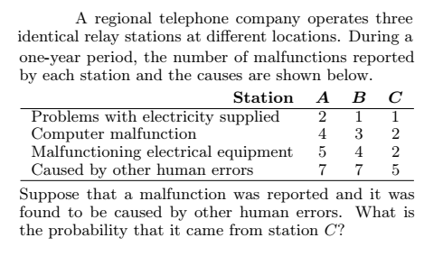
Notes:
0.2632 = P(C|E)
Grant total = 43, HumanErrorTotal = 19

